Slide 1



Concept, Strategy and Collaboration
ASEAN Initiative to foster next generation talents to lead environment-friendly food production, technological innovation and regional planning
AIMS Universities
・Agribusiness and farm environment management, food safety and processing technique for a sustainable food production
・Innovative Technology to balance value creation with environmental consideration
【Malaysia】
Universiti Putra Malaysia
Universiti Teknologi Malaysia
【Indonesia】
Bogor Agricultural University
Universitas Gadjah Mada
Institute of Technology Bandung
【Thailand】
Kasetsart University
King Mongkut’s University of Technology Thonburi
Educational programs utilizing strengths of the three universities to solve global challenges
・Environment-adaptive technologies to realize a safe regional planning and sustainable agriculture
・Promote proper use of technology towards our natural environment and city for tourism purposes
The three Universities will work with AIMS Universities to introduce educational programs to foster human resources towards solving challenges concerning Environmental Conservation and Economic Development
Notes:
Our title is:
ASEAN Initiative to foster next generation talents to lead environment-friendly food production, technological innovation and regional planning.
This is a joint project among the three universities.
Tokyo university of Agriculture and Technology has two faculties, Faculty of Agriculture is in charge of food production,
I am from Faculty of Engineering, and we are in charge of technological innovation.
Tokyo Metropolitan University is in charge of regional planning and tourism.
Ibaraki University is in charge of regional planning and food supply.
特徴
Our partners are
,

Slide 2
Demand for Human Resources to Solve Challenges
Facing ASEAN and Japan
Food Production Techniques that supports sustainable agriculture and higher added value
Innovation bringing economic development with awareness to environment
Sustainable regional systems for interactions between urban and rural regions
TUAT
IU
TMU
・Student Exchange (SSSV）
・AIMS for a semester
・Double Degree
・Joint Research Project
Thailand
Indonesia
Malaysia
[7 Universities, 4 Fields]
Foster Human Resources with broad vision and the will to challenge by Specialized Education Programs that comes from Specialized Fields of the Three JPU
(Agriculture, Engineering, Sustainability Science, Tourism)

Slide 3
Support for foreign students
Introduction of the Buddy System
Network building through Buddy System
Introduce the Buddy System for foreign students to support their life in Japan by studying together with partner Japanese students who will provide intensive support at classes and field works. Build alumni network through continuing support after their return to home countries.
Solving ASEAN’s challenges
Program Coordinators
Provide intensive support related to procedure for class registration, credit transfer and academic calendars.
J
A
A
J
A
J
International Exchange Coordinators
A
Provide wide support to facilitate their stay in Japan including English translation of various documents, plan/implementation of exchange programs with Japanese students, and consultation regarding residence.
J
A
J
A
J
J
J
A
Global Café and other exchange spaces
A
Enhancement
of exchange
Opening and management of Global Café and other international exchange spaces. Promotion of face book as a tool to enhance communication among Japanese and international students.
Support by clerical staff
Academic consultation prior to arrival in Japan
Provide academic consultation by TUAT’s ASEAN Office as well as by guest professors at AIMS affiliated institutions prior to arrival in Japan.
Three JPU will employ English speaking staffs at key departments and intensify quality support through continued information exchanges and training.
Provision of Accommodation
Available accommodations including dormitories and rented share-houses.

Slide 4
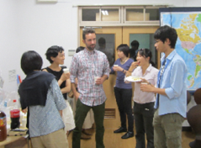
Support for Japanese Students
Buddy System
Pre-departure : outbound Japanese students will learn local language, custom, and culture from inbound Buddy students.
At the host university : inbound Buddy students in Japan, will support Japanese students as a Buddy at his/her university.
After returning : promote cross-cultural communication through planning/managing exchange and alumni events.
Global Cafe and other exchange spaces
Opening of Global Café and other international exchange spaces to promote international
communication.
International Exchange Coordinators
Provide support to brush up English conversation, pre-departure education on host country culture and custom, visa application.
Pre-Training
English: Intensive classes using outside language institutions targeted for students with TOEIC threshold score above 550.
ASEAN topography: classes on ASEAN’s natural environment, history culture, society and economy.
ASEAN mobility workshop: classes about ASEAN challenges offered by visiting ASEAN professors.
Support during studying abroad
Provide consultation at TUAT’s ASEAN Office as well as by guest professors at AIMS affiliated institutions on academic and daily matters.
Consultation through Skype and international advisor/mentor with academic experience in Japan.
Education after return to Japan
Result reporting: Presentation on the outcome of studying abroad to be held at joint study camp at Ibaraki University
Risk Management
Establishment of 24-hour emergency contact system and information collection/provision through alliance with professional risk management company.

Slide 5
Curriculum
 | Tokyo University of Agriculture and Technology |  | Ibaraki University | Tokyo Metropolitan University
 | Advanced Agro-Environmental and Food Technology Course | Environment-friendly Technological Innovation Course | Regional Sustainability Science Course | Regional Planning Course
Common Subjects | Introduction to International Environmental and Agricultural Science, IT Literacy, Introduction to Sustainable Engineering, Introduction to Regional Disaster Prevention, Tourism in Japan
 | 5 subjects/6 credits
Specialized Subjects | Food Production Technology related subjects | Innovation Fundamentals subjects | Climate Change Adaptive Measures-related subjects | Tourism-related subjects
 | Agricultural Environment and Production related subjects | Innovation Applied Technology subjects | Sustainable Development Society related subjects | Regional Environment related subjects
 | Environment and Material Cycle related subjects | Experiments | Experiments | Practical studies
 | Social Economy related subjects | Internship | Field studies | Workshops
 | Experiments and field practice | Workshops | Workshops
 | Workshops
 | 13 subjects/26 credits | 13 subjects/26 credits | 12 subjects/16 credits | 14 subjects/22 credits
Joint curriculum subjects | 3 subjects /6 credits | 2 subjects/4 credits | 4 subjects/8 credits | 2 subjects/4 credits
Total | 21 subjects/38 credits | 20 subjects/36 credits | 21 subjects/30 credits | 21 subjects/32 credits

Slide 7

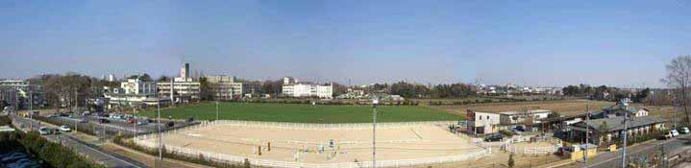
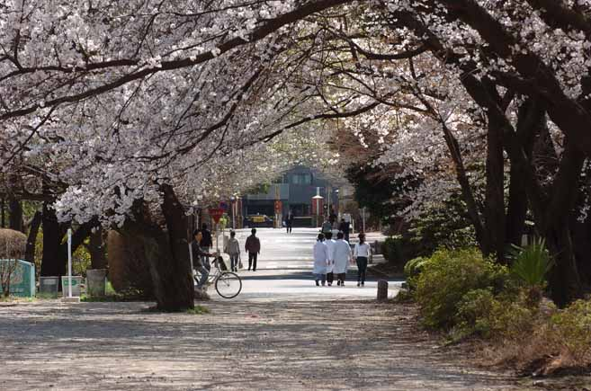
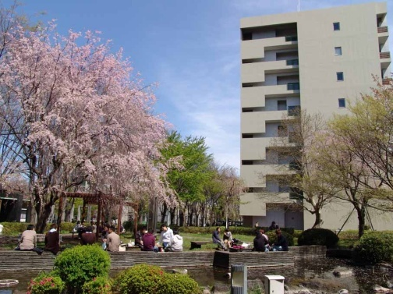
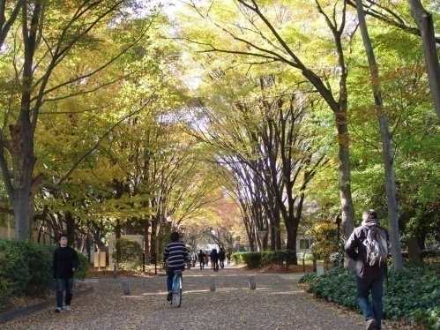
TUAT
Faculty of Agriculture, Faculty of Engineering and Faculty of Bio-Applications and Systems Engineering (BASE)
  400 Faculty members
  4,300 Undergraduate students, 2,000 Graduate Students
Fuchu campus (Faculty of Agriculture)
Koganei campus (Faculty of Engineering, BASE)
6
Notes:
TUAT is composed of three faculties. Faculty of Agriculture, Faculty of Engineering and Faculty of Bio-Applications and Systems Engineering (we call it BASE in short). TUAT is a rather small university. We have 400 faculty members, 4,300 Undergraduate students and 2,000 Graduate Students.
We have two campuses. One in Fuchu for the faculty of Agriculture and the other is for the faculty of Engineering. I belongs to the faculty of engineering, but I am living just beside the faculty of agriculture. This is the view from my home. This is an area for our horse riding club.

Slide 8
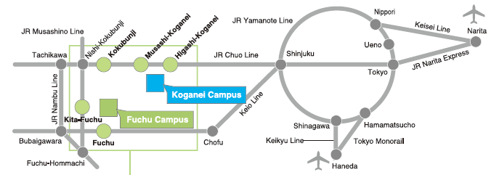
Where are we from?
Narita
Shinjuku
30minutes
Tokyo
High Quality of Life
7
Notes:
These two campuses are located in the west suburbs of Tokyo. This is Narita airport. This is the Tokyo station. This is the new center Shinjuku. And both the campuses are about 30 minutes from Shinjuku. We are very proud of very high quality of life around our campuses.

Slide 9
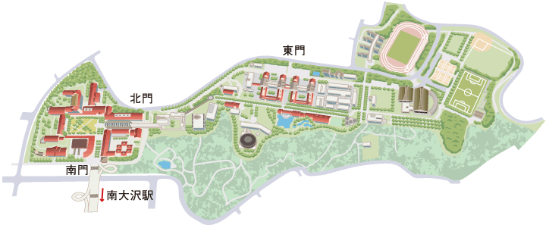
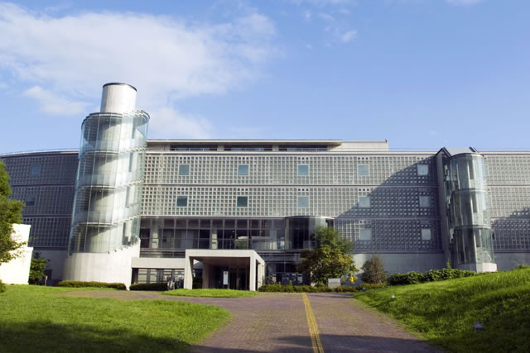
Tokyo Metropolitan University

Slide 10
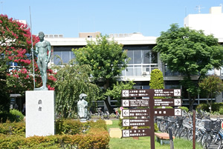
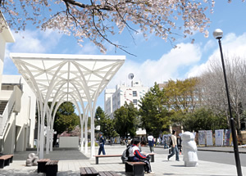
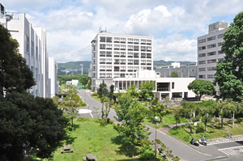
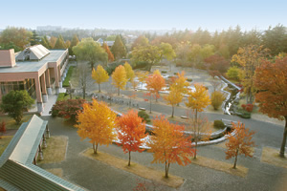
Ibaraki University

Slide 11

Spectrum of Globalization
Foreign students to come!
More Int’l Collaboration
More Int’l Faculty
Japanese to study abroad!
fly!
(Ph.D. or Post Dr.)
jump!
(Regular Programs: 2 years or more)
step!
(Short Term Exchange: 1 year)
hop!
(Short Stay: 2 weeks to 3 months)
10
Notes:
10

